Slide 1
Resilience

Slide 2
What is resilience and how resilient are you?
Take the quiz

Slide 3
I try to see the humorous side of things when I am faced with problems
Not true at all (1) Rarely true (2) Sometimes true (3) Often true (4) True nearly all the time (5)
Having to cope with stress can make me stronger
Not true at all (1) Rarely true (2) Sometimes true (3) Often true (4) True nearly all the time (5)
I believe I can achieve my goals, even if there are obstacles
Not true at all (1) Rarely true (2) Sometimes true (3) Often true (4) True nearly all the time (5)
Under pressure, I stay focussed and think clearly
Not true at all (1) Rarely true (2) Sometimes true (3) Often true (4) True nearly all the time (5)

Slide 4
I am able to adapt when changes occur
Not true at all (1) Rarely true (2) Sometimes true (3) Often true (4) True nearly all the time (5)
I am not easily discouraged by failure
Not true at all (1) Rarely true (2) Sometimes true (3) Often true (4) True nearly all the time (5)
I can deal with whatever comes my way
Not true at all (1) Rarely true (2) Sometimes true (3) Often true (4) True nearly all the time (5)
I tend to bounce back after illness, injury or hardships
Not true at all (1) Rarely true (2) Sometimes true (3) Often true (4) True nearly all the time (5)

Slide 5
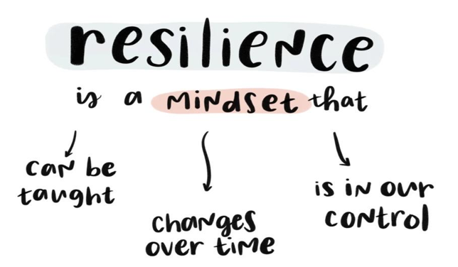
WHAT IS RESILIENCE?
Being resilient means being able to cope with life’s setbacks and to quickly bounce back.
Anyone scoring 24+ is fairly resilient but there is always room for improvement!

Slide 6
HOW TO BUILD OUR RESILIENCE
Think of a current goal, what internal and external factors will help you achieve this?
Internal factors (what I eat, how I feel, knowing my own strengths)
External factors (support from friends, family and professionals, life challenges)

Slide 7
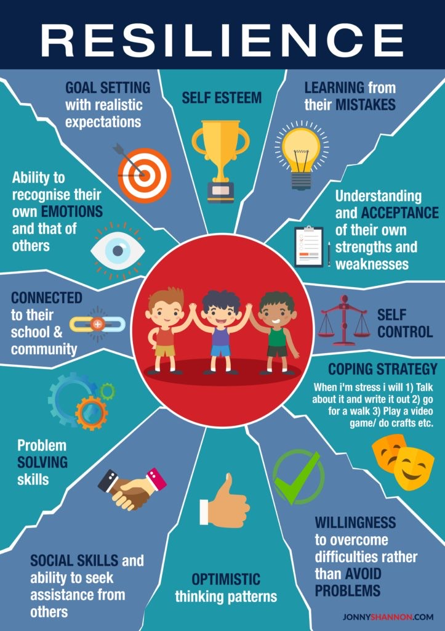

Slide 8
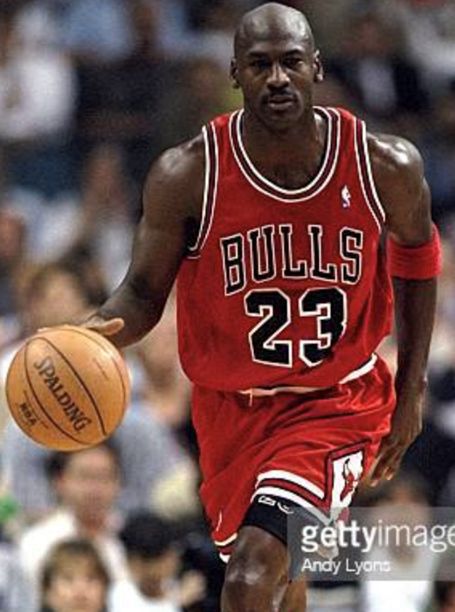
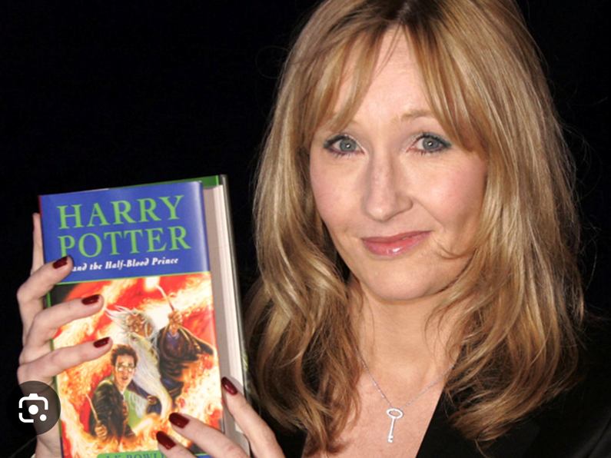
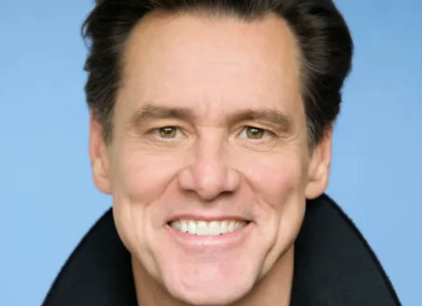
GUESS WHO?
Which of these public figures have reached their goals by developing resilience despite life’s challenges?

Slide 9
The resilience plan
The 4 S’s

Slide 10
Supportive People
People who gave you advice, or perhaps helped
you develop a new, more helpful perspective

Slide 11
Strategies
Methods and approaches you implemented
to deal with difficult thoughts and feelings

Slide 12
Sagacity
Wisdom and insights that may have been helpful

Slide 13
Solution-seeking behaviours
Planning, for instance, or searching for useful information.

Slide 14
NEVER GIVE UP!
https://youtu.be/UNQhuFL6CWg

Slide 15
THREE TOUCH CHALLENGE
Partner up and see who can get their counter to hang over the opposite end of the table before flipping it up and catching it

