Slide 1
British Values

Slide 2
British Values
The Rule of Law
Democracy
Individual Liberty
Mutual respect of those with different faiths and beliefs

Slide 3
British Values
The Rule of Law
Democracy
Individual Liberty
Mutual respect of those with different faiths and beliefs

Slide 4
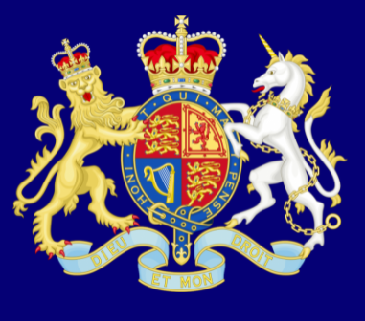
Recap
The Rule of Law
What is it?
The rule of law is what keeps our society together and what helps us live a happy life.

Slide 5
Recap
Democracy
What is it?
Democracy means ‘rule by the people’.

Slide 6
Individual Liberty
Recap
What is it?
I’m free to be me!

Slide 8
Task
1. Make a list of everyone that has shown you respect
2. Why did you add them to your list?

Slide 9
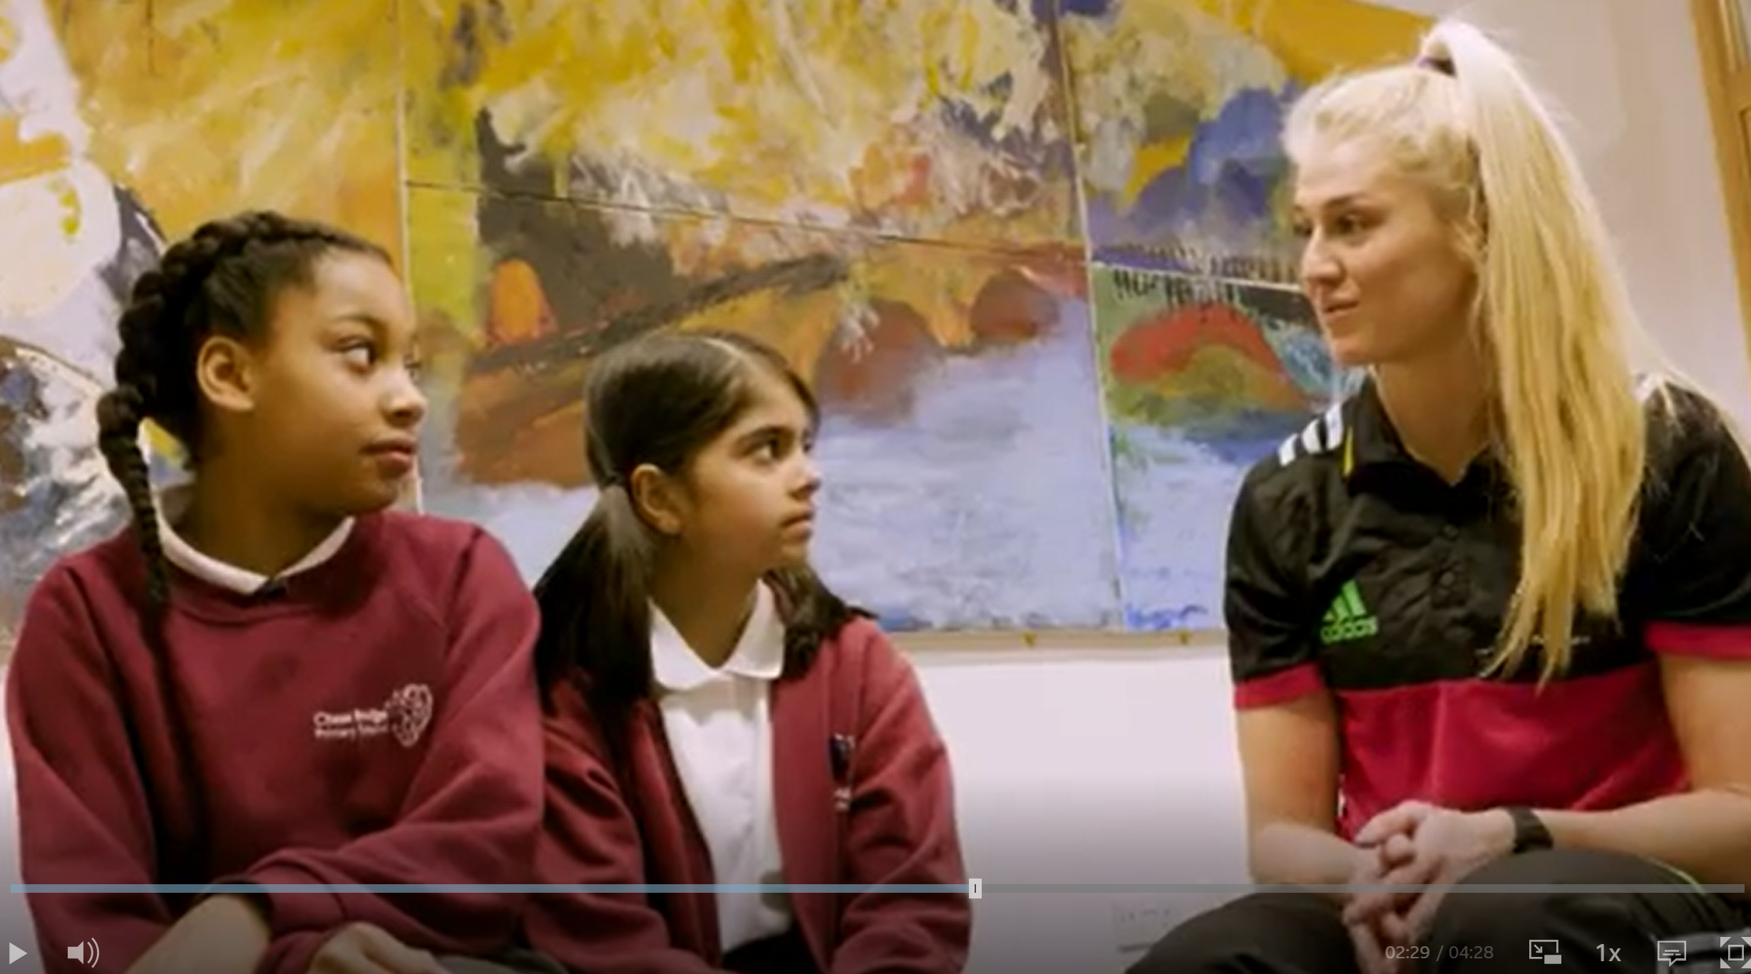
Mutual respect for different faiths and beliefs
https://www.bbc.co.uk/teach/school-radio/assemblies-ks1-ks2-british-values-mutual-respect/zp8yhcw

Slide 10
When is it easy to show respect?
When is it harder to show respect?
Do you have to earn respect?
If so, what do you have to do to earn it?
What do you need to do to show respect?

Slide 11
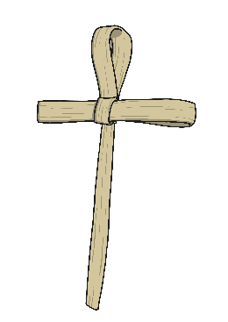
Starter task
Can you name as many different faiths as you can?
Work with a partner and write them down!

Slide 12
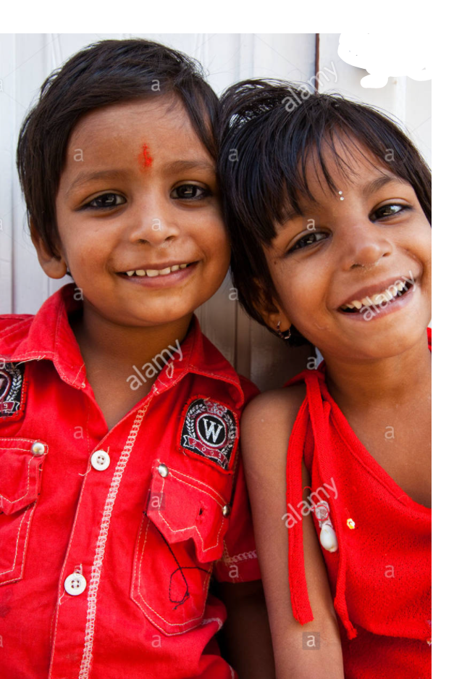
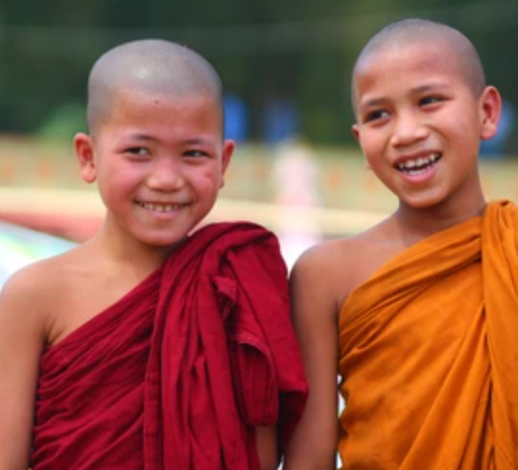
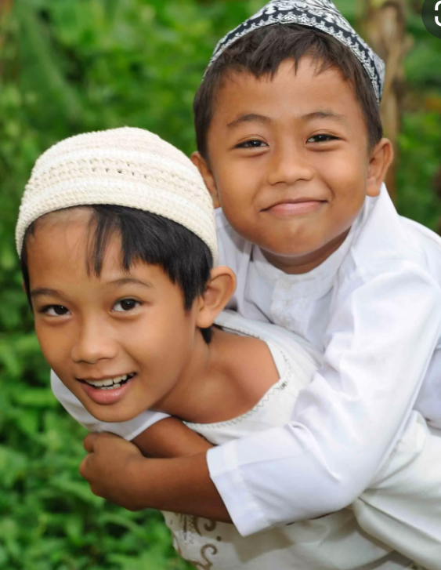
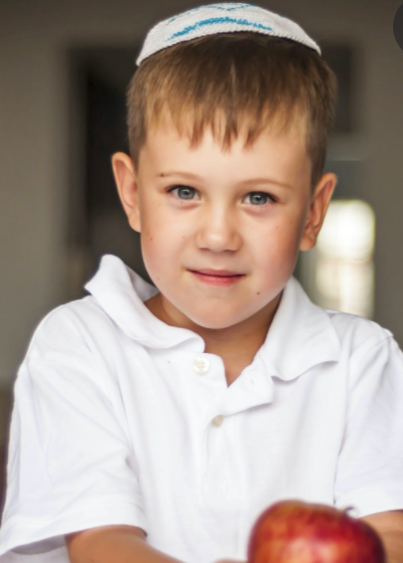
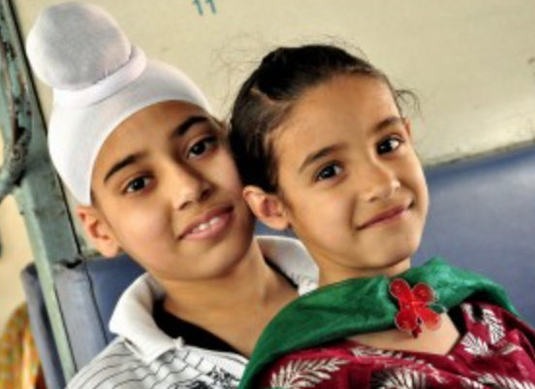
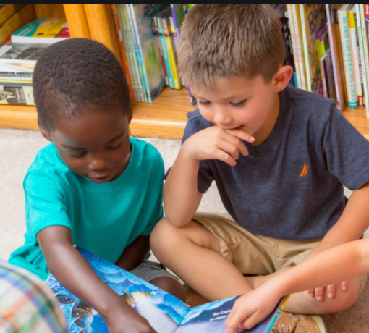
Mutual Respect for Different Faiths and Beliefs
There are lots of different people in Britain who all have different faith and beliefs.
It is very important that we treat others how we would like to be treated, with mutual respect, tolerance and we should pride ourself on being a genuinely good person.
What personal qualities
can we show each day?
Hindus
Buddhists
Muslims
Jews
Sikhs
Christians

Slide 13
Physical Activity
We are going to play a few active games.
Respect
How can you show respect during different activities?

