Slide 1
British Values

Slide 2
British Values
The Rule of Law
Democracy
Individual Liberty
Mutual respect of those with different faiths and beliefs

Slide 3
British Values
The Rule of Law
Democracy
Individual Liberty
Mutual respect of those with different faiths and beliefs

Slide 4
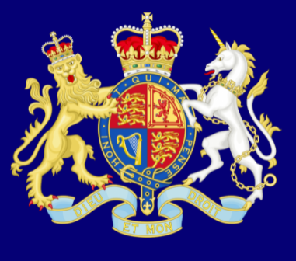
Recap
The Rule of Law
What is it?
The rule of law is what keeps our society together and what helps us live a happy life.

Slide 5
Recap
Democracy
What is it?
Democracy means ‘rule by the people’.

Slide 6
Individual Liberty
Recap
What is it?
‘I’m free to be me!’.

Slide 7
Mutual Respect for Differences
How many of you have ever felt left out?
Or have you owned an item that you didn’t want to share?
If you were made to share, did it make you happier or sadder?
Is being unique more important than being liked?

Slide 8
https://www.youtube.com/watch?v=QFORvXhub28

Slide 9
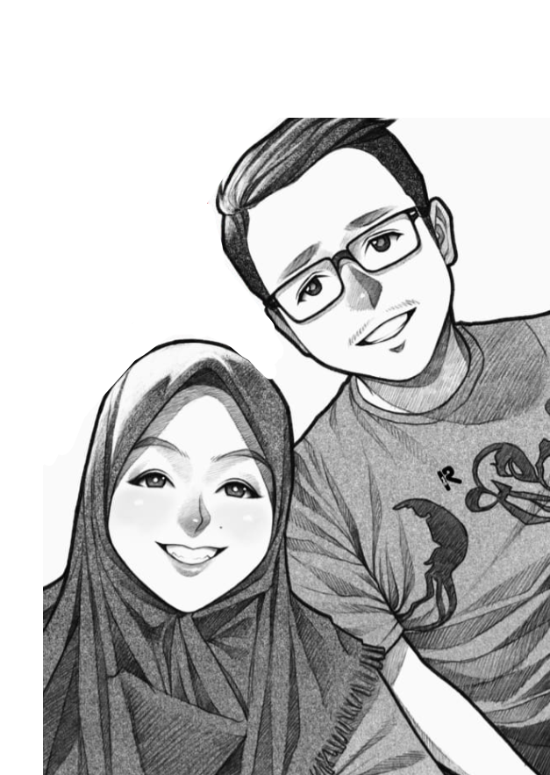
Task:
Think of a person you know, it could be a friend, a family member – anybody!
1. Write their names or draw them on your paper.
Joe
me
2. Write some similarities and differences about you both.
What is the same about you both?
What is different?

Slide 10
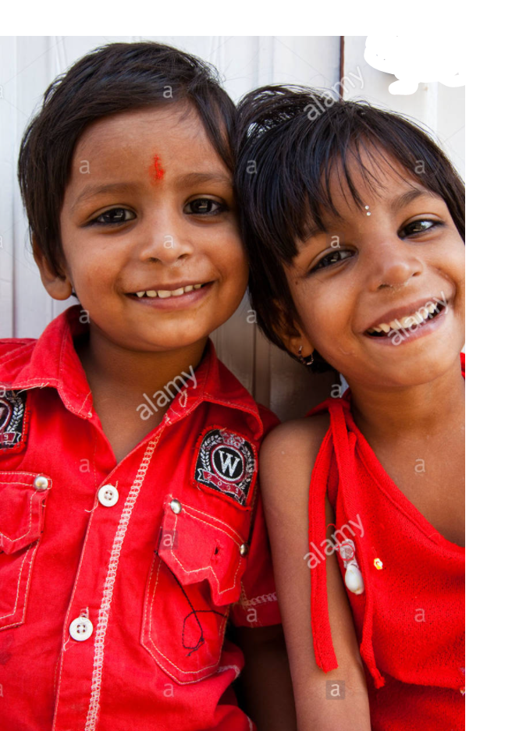
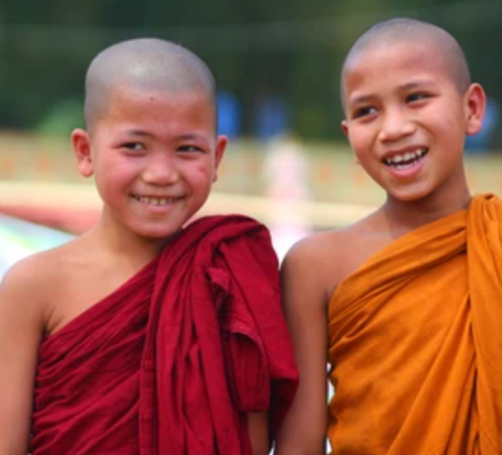
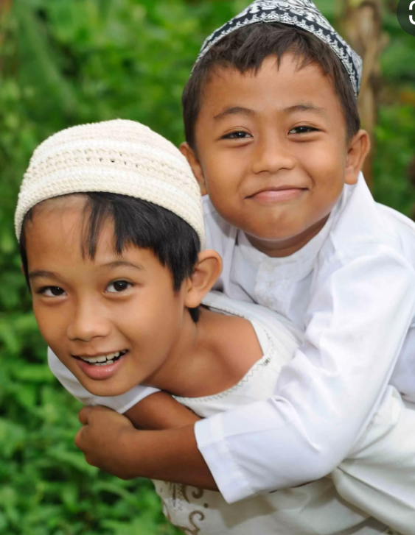
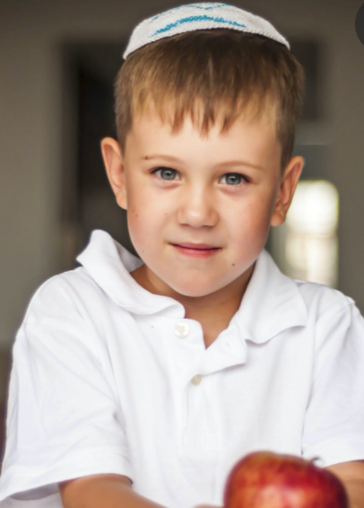
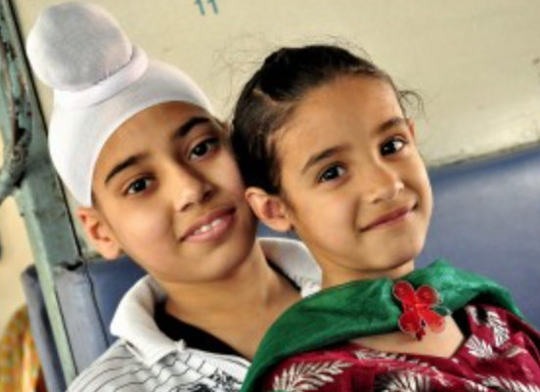
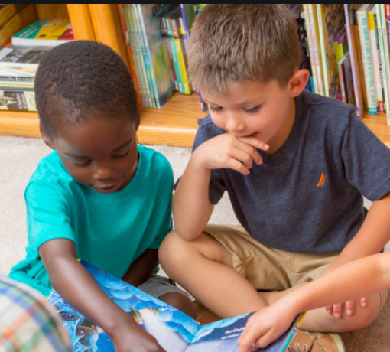
Mutual Respect for Differences
There are lots of different people in Britain who all have different beliefs. People look different and believe in different things.
It is very important that we treat others how we would like to be treated.
Share things, show respect and be a good person to everyone
Hindus
Buddhists
Muslims
Jews
Sikhs
Christians

Slide 11
Mutual Respect for Different Faiths
What is it?
What is mutual respect?
What are different faiths?

Slide 12
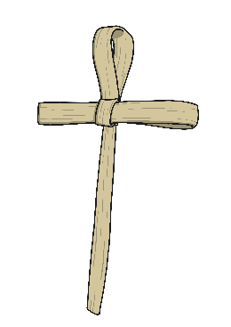
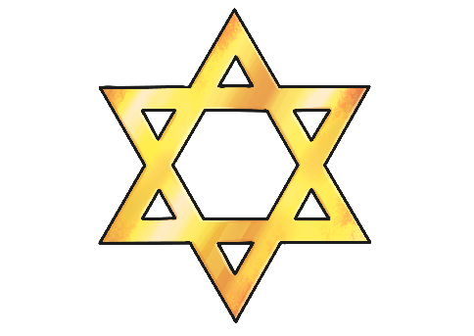
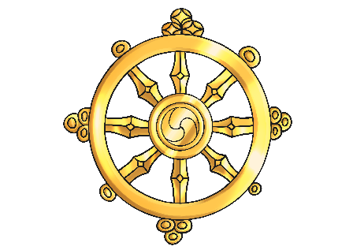
Can you name as many different faiths as you can?

Slide 13
Physical Activity
We are going to play a few active games.
Respect
How can you show respect during different activities?

