Slide 1
British Values

Slide 2
British Values
The Rule of Law
Democracy
Individual Liberty
Mutual respect of those with different faiths and beliefs

Slide 3
British Values
The Rule of Law
Democracy
Individual Liberty
Mutual respect of those with different faiths and beliefs

Slide 4
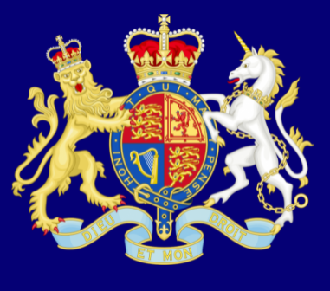
The Rule of Law
What is the law?

Slide 5
The Rule of Law
What is the law?
A set of rules we must follow or we may face penalties.

Slide 6
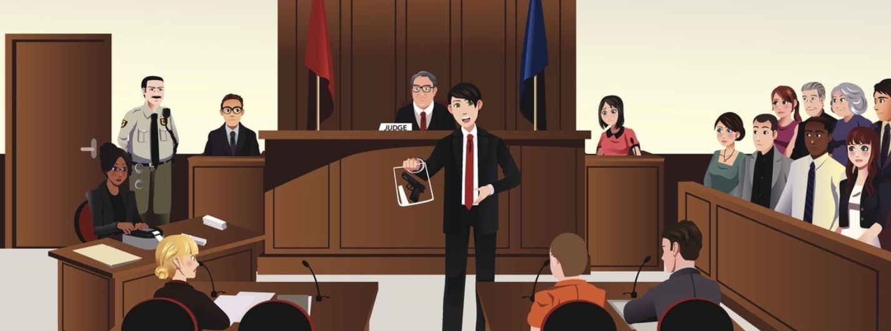
Why does Britain
have a legal system?

Slide 7
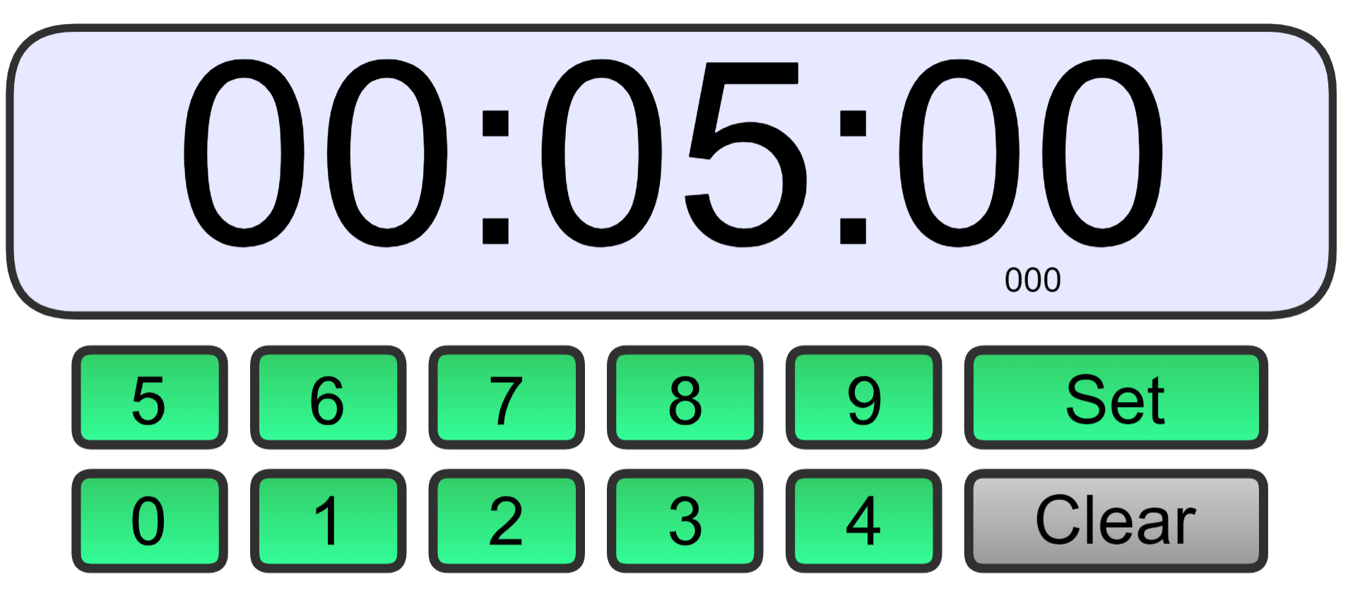
TASK:
Time Challenge
Can you write down as many laws which we currently
in Britain today.
You may want to work with a partner!

Slide 8
There are two types of law
Civil Law
and
Criminal Law
Offences against society.
Rights and duties of citizens (people) dealing with other citizens.
E.g vandalism and theft
E.g marriage and lending money

Slide 9
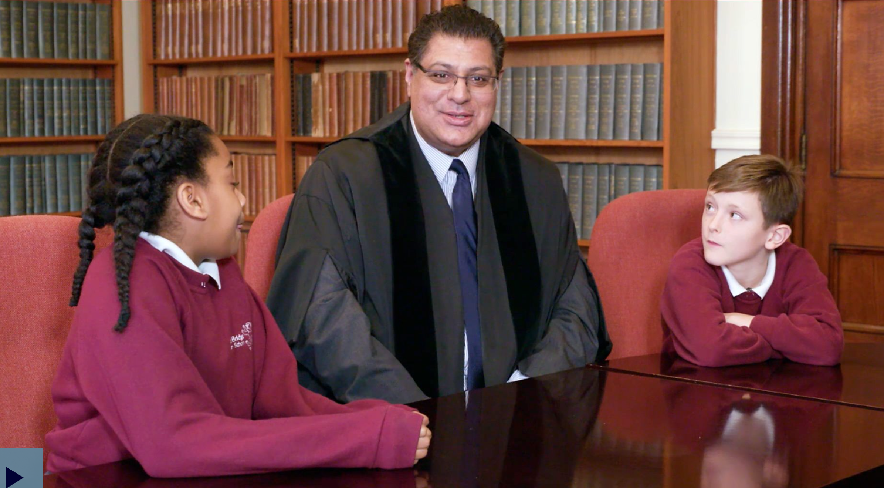
The Rule of Law
https://www.bbc.co.uk/teach/school-radio/assemblies-ks1-ks2-british-values-the-rule-of-law/zc2bsk7

Slide 10
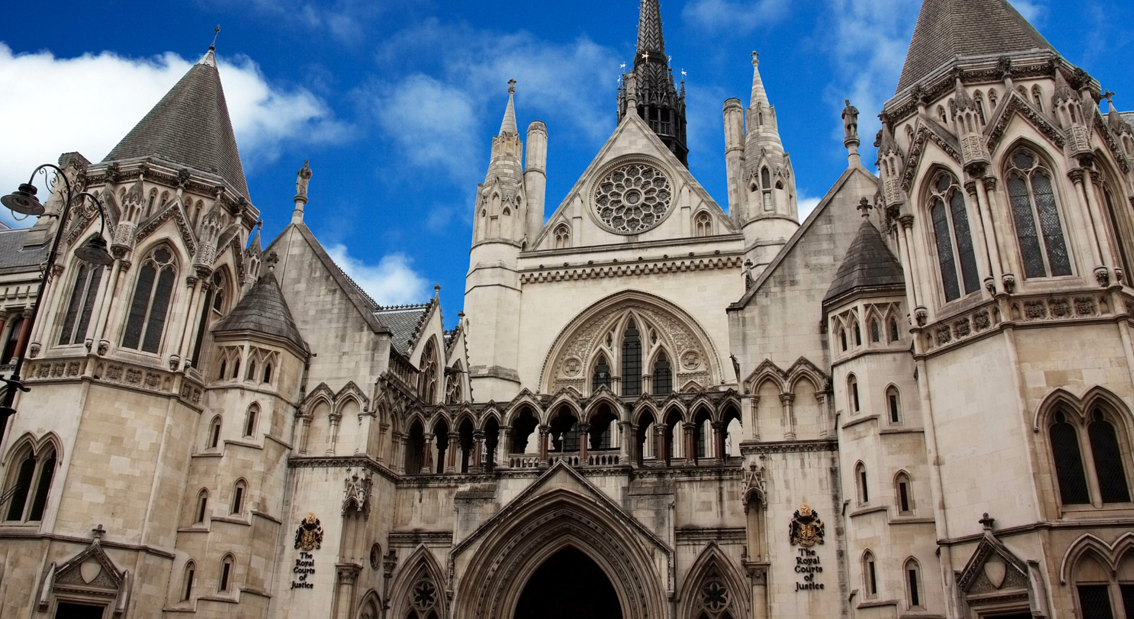
The Central Criminal Court of England and Wales, The Old Bailey. It is a crown court in London.

Slide 11
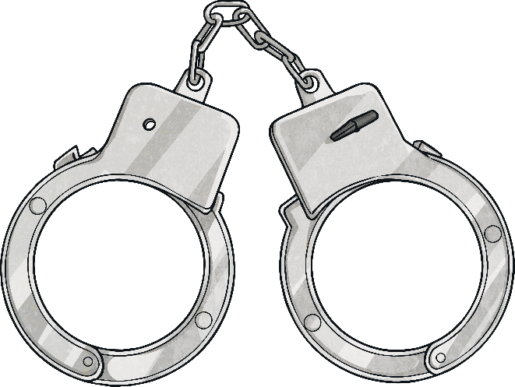
Punishment
In criminal courts, the aim is to punish wrongdoers and impose a sentence which prevents them from reoffending.
Sentence
Mostly imprisonment, a fine and/or other punishments for the person who was convicted of the crime.
or
Compensation
In civil law, the courts award compensation when someone can prove the other party is in the wrong.
Compensation
Giving a person money or other things of value to provide for the costs of injuries that they have had.

Slide 12
Why are rules and laws so important?
Without them it would be chaos. People need to know what they can and can’t do.

Slide 13
What would happen if we didn’t have laws?
There would be chaos and there would be lots of unhappy people.

Slide 14
Physical Activity
We are going to play a team game with careful rules. Then play it again where you say the rules don’t matter.
What happens?
After both games we will talk about what happens.
Will the game feel pointless without the rules?

