Slide 1
British Values

Slide 2
British Values
The Rule of Law
Democracy
Individual Liberty
Mutual respect of those with different faiths and beliefs

Slide 3
British Values
The Rule of Law
Democracy
Individual Liberty
Mutual respect of those with different faiths and beliefs

Slide 4
The Rule of Law
What is it?
The rule of law is what keeps our society together and what helps us live a happy life.

Slide 5
Watch the video to see if you can answer our questions.
Take a question (1 between 3)
As you watch the video for a second time, can you find the answer
to your question?

Slide 6
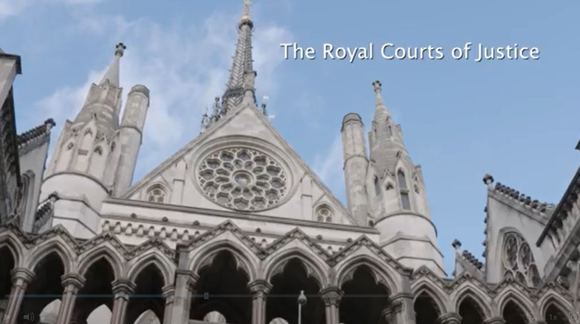
Watch and enjoy…
https://www.bbc.co.uk/teach/school-radio/assemblies-ks1-ks2-british-values-the-rule-of-law/zc2bsk7

Slide 7
Why are there rules and laws?
To make sure everyone stays safe.

Slide 8
Why are rules and laws so important?
Without them it would be chaos. People need to know what they can and can’t do.

Slide 9
What is the job of a judge?
Judges are experts in the law. They decide if people have or have not broken the law and if they have, they decide on what consequence they will receive.

Slide 10
What is a sentence?
The punishment a judge decides must be given to a person who is found guilty of breaking the law.

Slide 11
What are consequences?
Consequences are punishments. This depends on what you have done and how bad it is.

Slide 12
What are the two types of law?
Criminal law
Civil Law
Offences against society
Rights and duties of citizens (people) dealing with other citizens.
E.g vandalism and theft
E.g marriage and lending money

Slide 13
What is good about our laws in Britain?
They are fair because they have been developed over hundreds of years.

Slide 14
What would happen if we didn’t have laws?
There would be chaos and there would be lots of unhappy people.

Slide 15
What do laws help us to do?
It keeps us living happy lives together as a society.

Slide 16
Task
What rules do we have in class? At school? At home?
Choose a place and write the rules.

Slide 17
Physical Activity
We are going to play a team game with careful rules. Then play it again where you say the rules don’t matter.
What happens?
After both games we will talk about what happens.
Will the game feel pointless without the rules?

