Slide 1
British Values

Slide 2
British Values
The Rule of Law
Democracy
Individual Liberty
Mutual respect of those with different faiths and beliefs

Slide 3
British Values
The Rule of Law
Democracy
Individual Liberty
Mutual respect of those with different faiths and beliefs

Slide 4
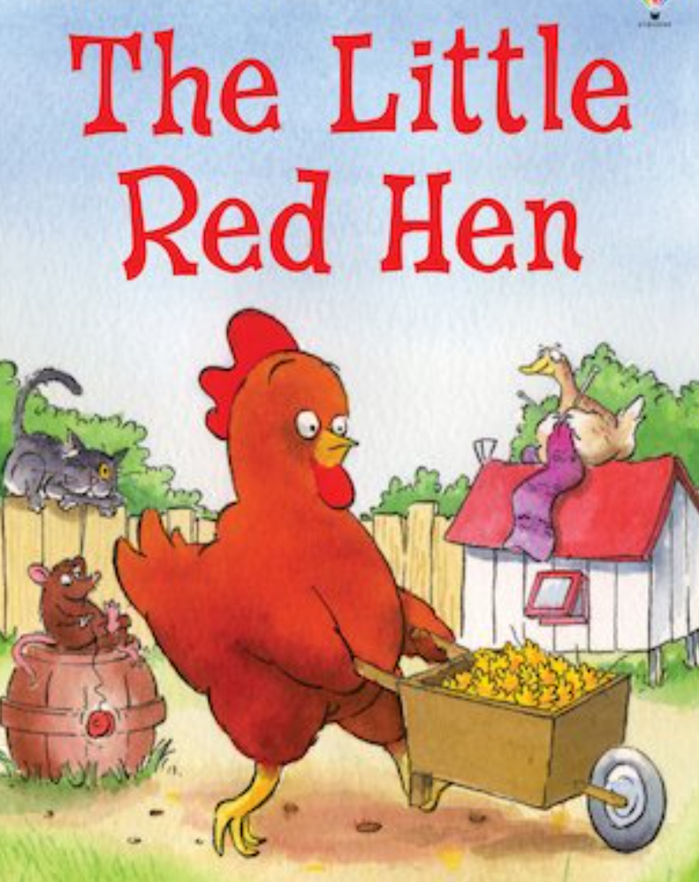
https://www.youtube.com/watch?v=GLzna0Hrsco
Play to 2.31

Slide 5
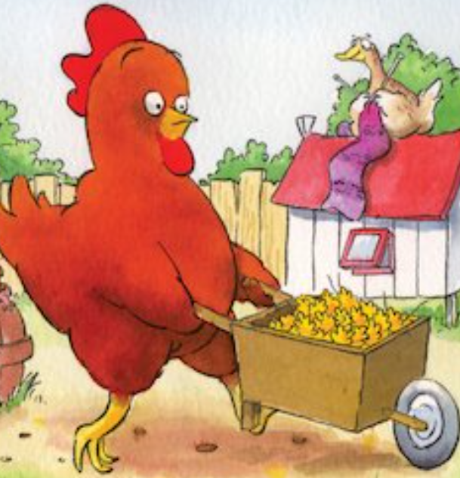
What kind of character is the hen?
What kind of characters are the other
animals?
Why didn’t the other animals want to help?
What could they achieve if they
worked together?
Would having rules be helpful?
Is this true in real life?

Slide 6
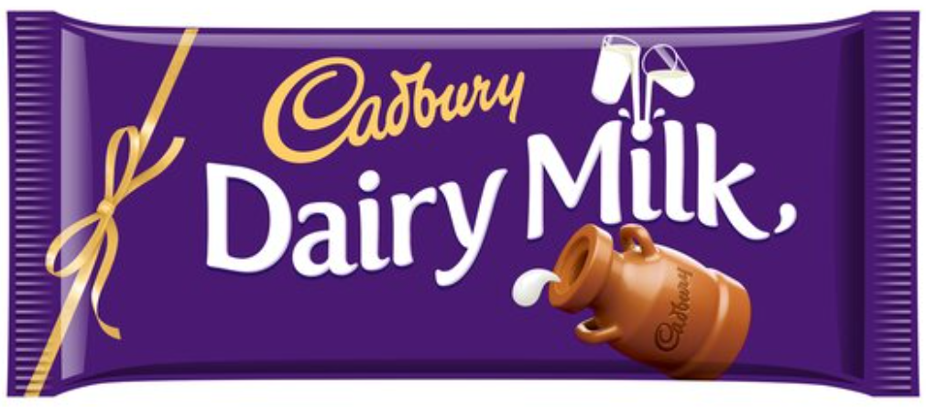
“The boys can have bigger pieces”
“If you have brown eyes
you can’t have any”
Is this fair?
What can we do about it?
“If you have blue socks on you can have 2 pieces”

Slide 7
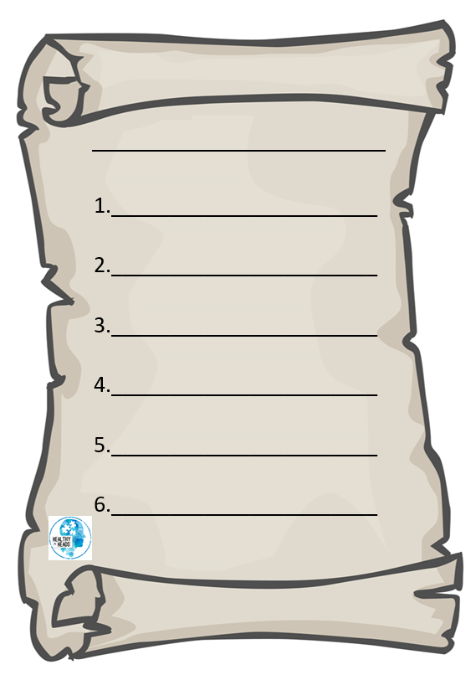
Task
What rules do we have in class? At school? At home?
Choose a place and write the rules.

Slide 8
The Rule of Law
How do rules help us?

Slide 9
The Rule of Law
What happens when we break these rules?

Slide 10
Physical Activity
We are going to play a team game with careful rules.
Let’s see who can follow the rules properly
KEY QUESTION:
How do rules help us?

