Slide 1
British Values

Slide 2
British Values
The Rule of Law
Democracy
Individual Liberty
Mutual respect of those with different faiths and beliefs

Slide 3
British Values
The Rule of Law
Democracy
Individual Liberty
Mutual respect of those with different faiths and beliefs

Slide 4
Recap
The Rule of Law
What is it?
The rule of law is what keeps our society together and what helps us live a happy life.

Slide 5
Recap
Democracy
What is it?
Democracy means ‘rule by the people’.

Slide 6
Individual Liberty
Let’s play a game of
‘Put your hand up if.....’

Slide 7
Put your hand up if........
You drink milk
Like football
Can speak another language
You like swimming in the sea
Know what you want to be when you’re older

Slide 8
All these things help
make up your
identity!

Slide 9
Individual Liberty
Task:
What makes you, you!?
Write down three things that you like:
What you like to eat
What you like doing
What animals you like.
See… we all have liberty – or freedom to think about things we want to.
Having liberty means we are able to make certain choices.

Slide 10
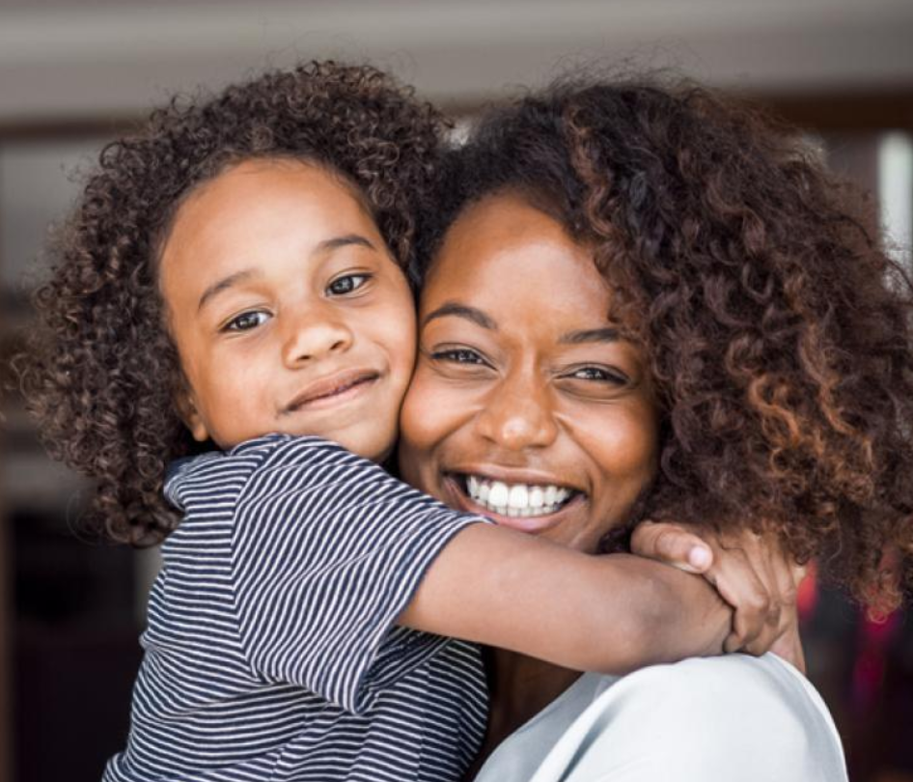
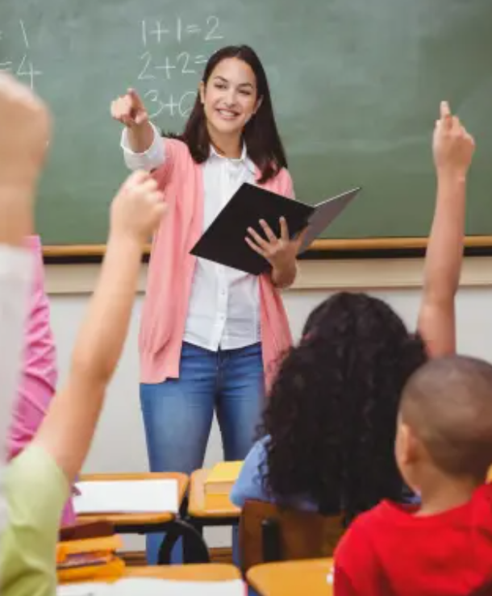
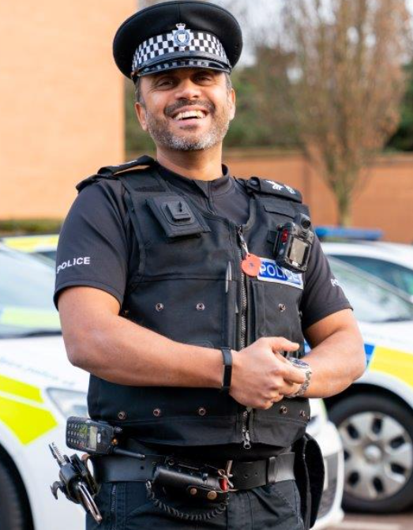
Individual Liberty
Having individual liberty but this does not mean people can do what they want.
Parents keep us warm, safe and healthy.
Teachers help us learn and be safe
Police officers maintain law and order in the community
Doctors give us health advice we must follow to be healthy.
There are rules to follow to keep everyone safe that we must respect and it is important to follow advice from certain people.

Slide 11
Individual Liberty In Britain, as long as we do not break the law and we act responsibly, we can live as we choose to and have our own opinions about things.

Slide 12
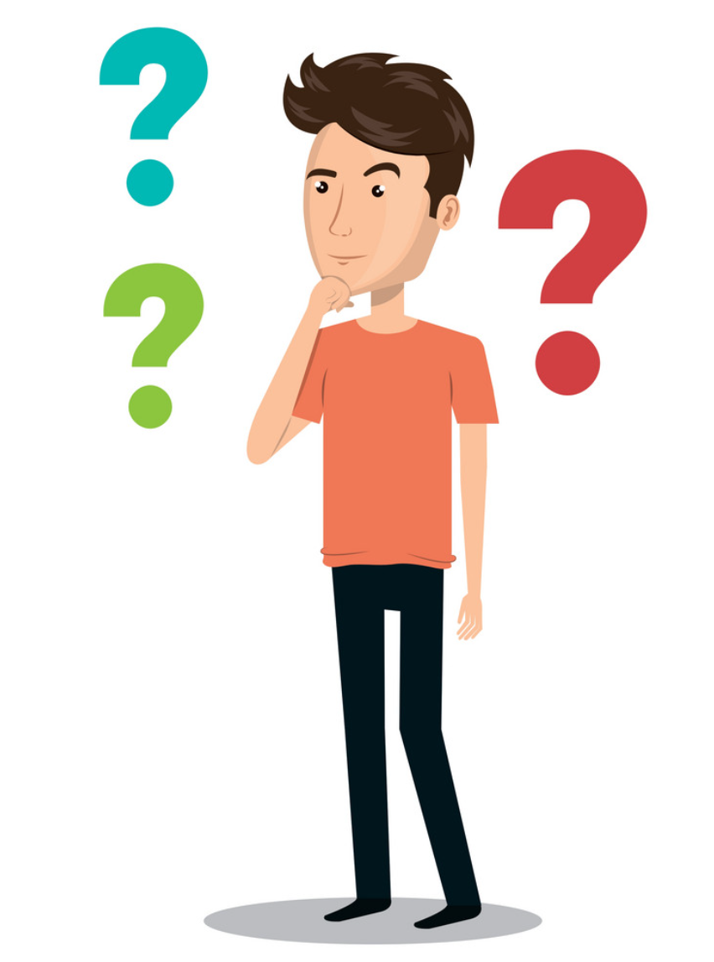
Individual Liberty
There may be times when we try to stop people having their individual liberty.
Think about a time you have tried to get someone to do something you wanted them to
How might they
have felt?
How could you have
behaved differently?
How did it make
you feel?

Slide 13
What you value also makes up part of who you are.
If you think that it is important to you, if it is something you value, then give me a thumbs up – if not, it’s thumbs down.

Slide 14
ambitious
sporty
kind
musical
hard working
determined
friendly
honest
caring
fun

Slide 16
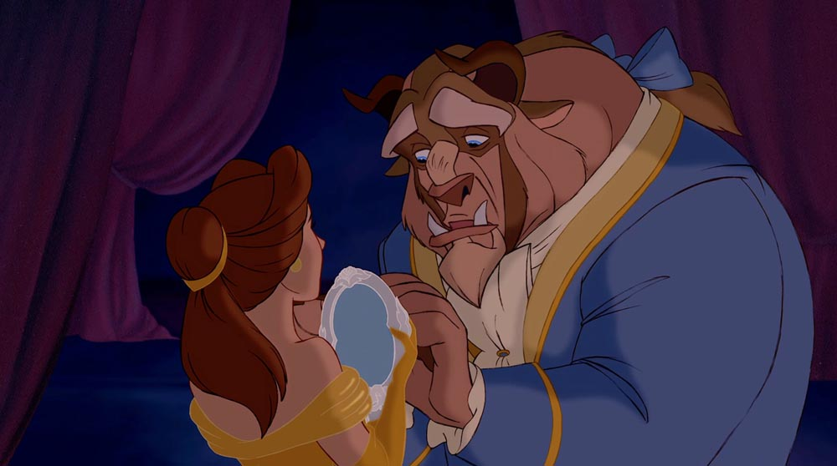
https://www.youtube.com/watch?v=p9UmgMemTpc

Slide 18
Physical Activity
We are going to play different multi-skill games.
Can you make your own choices for each game based on your thoughts and feelings?
KEY QUESTION:
What decisions can I make for myself?

