Slide 1
British Values

Slide 2
British Values
The Rule of Law
Democracy
Individual Liberty
Mutual respect of those with different faiths and beliefs

Slide 3
British Values
The Rule of Law
Democracy
Individual Liberty
Mutual respect of those with different faiths and beliefs

Slide 4
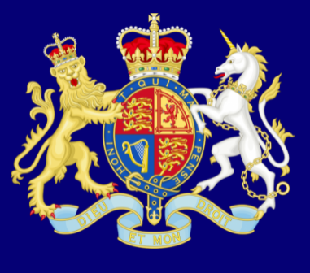
Recap
The Rule of Law
What is it?
The rule of law is what keeps our society together and what helps us live a happy life.

Slide 5
Recap
Democracy
What is it?
Democracy means ‘rule by the people’.

Slide 6
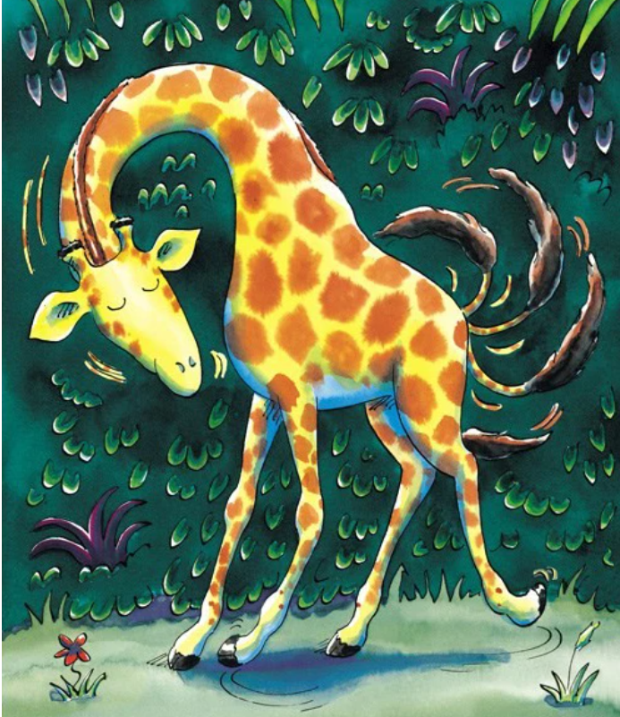
Individual Liberty
Has someone ever helped you learn how to do something new?
How did they feel once they learned how to do it?
How did they feel when they could not do what everyone else was doing?

Slide 7
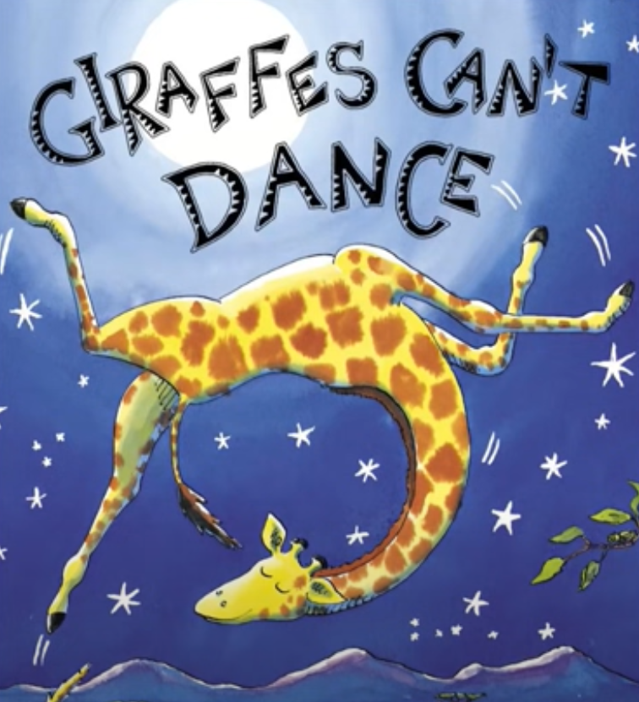
Individual Liberty
https://www.youtube.com/watch?v=Zzb5Acl-n70

Slide 8
Individual Liberty
Is it important that everyone is able to do the same thing well?
What did Gerald have to do in order to become a dancer?
Why do you think the author wrote this story?
What did he want children to learn from Gerald's experience?

Slide 9
sway
twist
shuffle
turn
How did you feel – dancing in your own way
and hearing nice words?
skip
prance
freeze
jolt

Slide 10
Individual Liberty
What is it?
I’m free to be me!

Slide 11
Physical Activity
We are going to play different multi-skill games.
Can you make your own choices for each game based on your thoughts and feelings?
KEY QUESTION:
What decisions can I make for myself?

