Slide 1
British Values

Slide 2
British Values
The Rule of Law
Democracy
Individual Liberty
Mutual respect of those with different faiths and beliefs

Slide 3
British Values
The Rule of Law
Democracy
Individual Liberty
Mutual respect of those with different faiths and beliefs

Slide 4
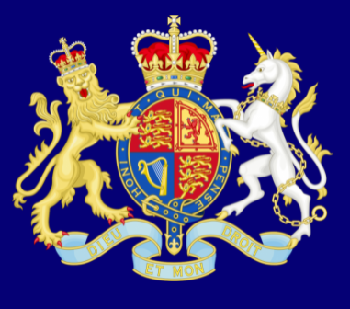
Recap
The Rule of Law
What is it?
The rule of law is what keeps our society together and what helps us live a happy life.

Slide 5
Democracy
What is it?
Democracy means ‘rule by the people’.
It comes from the Greek words Dêmos, which means people, and krátos which means rule or strength.

Slide 6
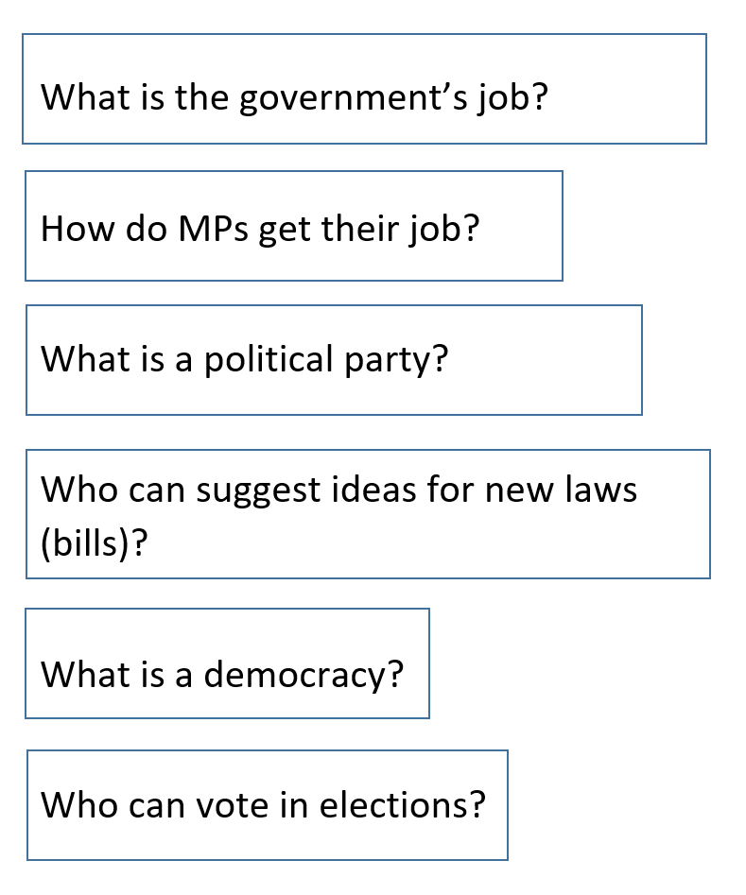
Challenge
As we watch the video can you work in teams to answer
as many of these questions as you can?

Slide 7
https://learning.parliament.uk/en/resources/introduction-to-parliament-primary-video/

Slide 8
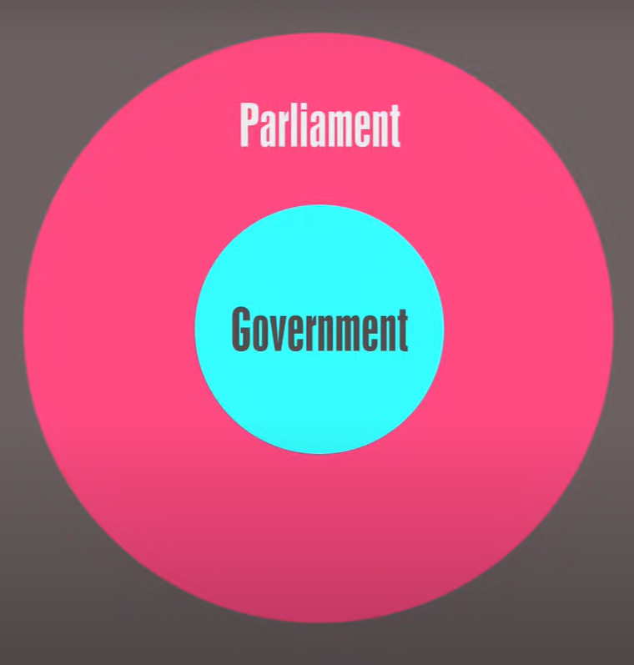
What is the job of the government?
To run the country
(parliament checks and challenges what the government does)

Slide 9
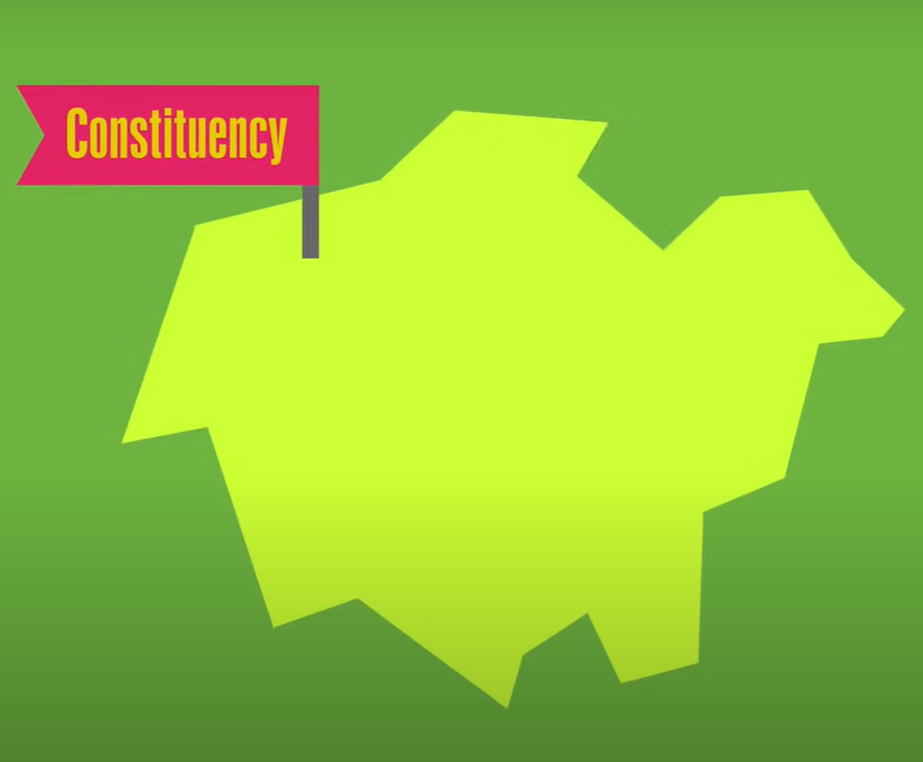
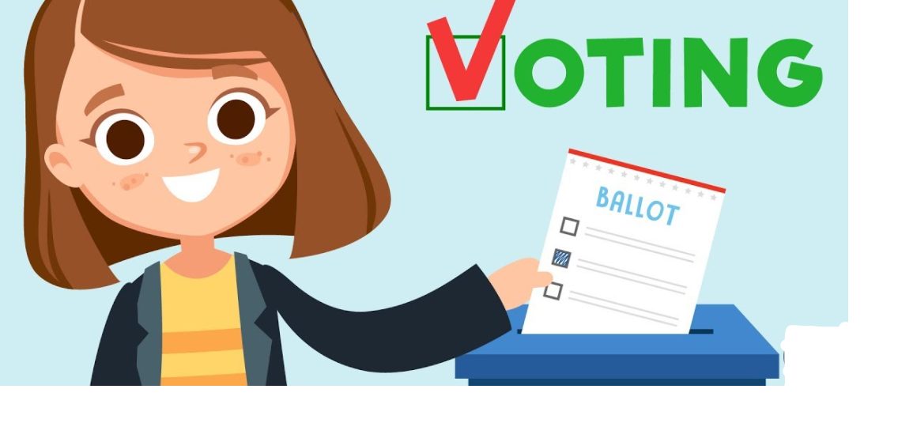
How to MPs get their job?
They are voted for by the people in their area (constituency) .
Areas of the UK

Slide 10
What is a political party?
A group of people with similar views on how our country should be run.

Slide 11
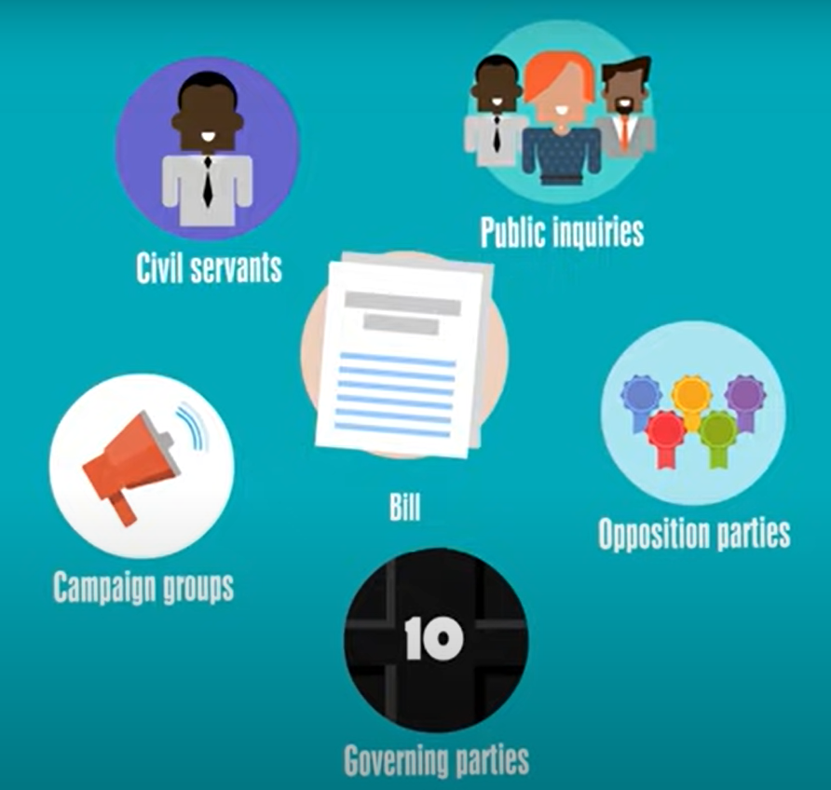
Who can suggest ideas for new laws (bills)?
Lots of different people including political parties and campaign groups

Slide 12
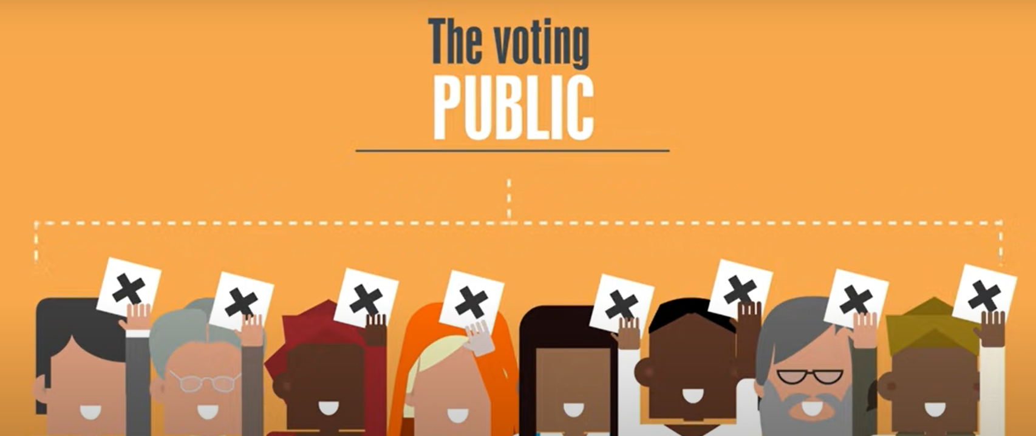
What is a democracy?
As many people as possible can have a say in how the country is run.
People can vote in elections.

Slide 13
Who can vote?
Every eligible person age 18 and over can vote!

Slide 14
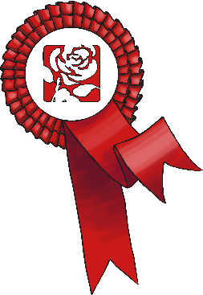
In Britain we hold an election to choose someone to represent us.
Most candidates who ’stand’ for election belong to a political party
– a group of people who share similar beliefs.
People who belong to the party agree on changes they will make if they are elected. These are called policies.

Slide 15
Can you name any political parties?
Conservative
Labour
SNP
Liberal Democrats
Plaid (Wales)
Green Party
Can you name their leaders?

Slide 16
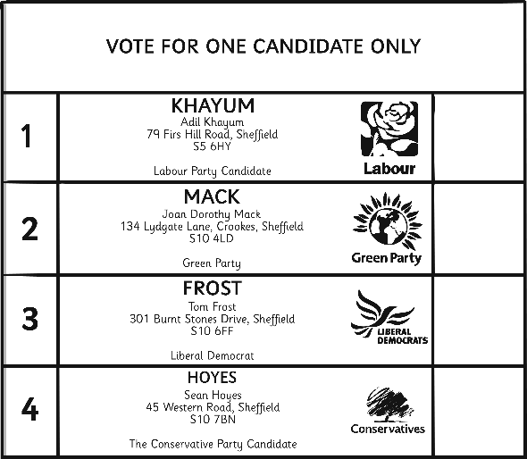
Voting
1. People must be 18 or over in order to take part in an election.
2. Every citizen should listen to the views of the different parties and candidates and then make his or her own decision on whom to support.
3. Each person (voter) votes (‘casts a ballot’) for the candidate of his or her choice. S/he does this by putting a cross beside the person’s name on the ballot paper.
4. People cast their ballots in a booth so that no one can see who they are voting for. This is called a ‘secret ballot’.
5. At the end of the election day, the votes are added up
and the candidate with the highest number of
votes (the majority) is declared the winner.

Slide 17
Democracy
What is it?
Democracy means ‘rule by the people’.
As many people as possible can have a say in how the country is run!
How can you have a say in how the country is run?
Use your vote!

Slide 18
Physical Activity
We are going to play different multi-skill games.
Can we vote on some different rules for each game?
KEY QUESTION:
What is democracy?

