Slide 1
British Values

Slide 2
British Values
The Rule of Law
Democracy
Individual Liberty
Mutual respect of those with different faiths and beliefs

Slide 3
British Values
The Rule of Law
Democracy
Individual Liberty
Mutual respect of those with different faiths and beliefs

Slide 4
Recap
The Rule of Law
What is it?
The rule of law is what keeps our society together and what helps us live a happy life.

Slide 5
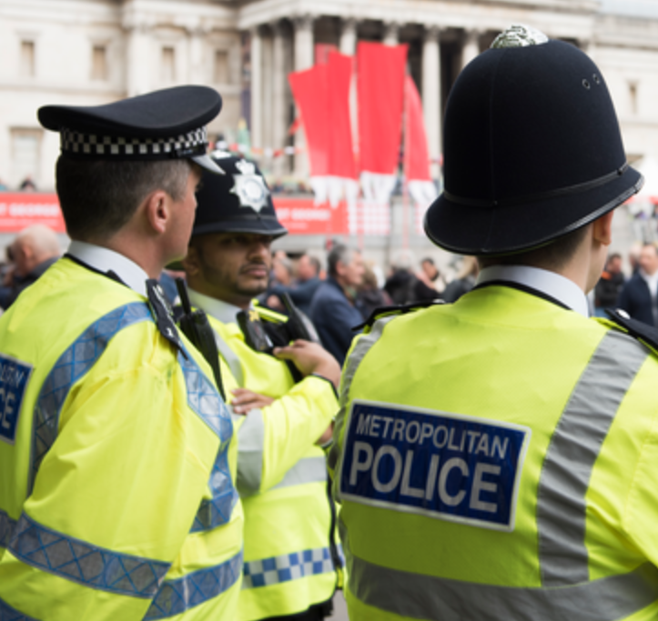
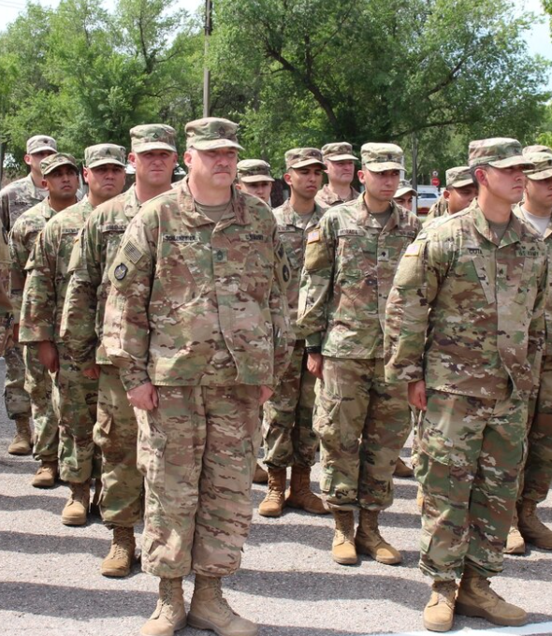
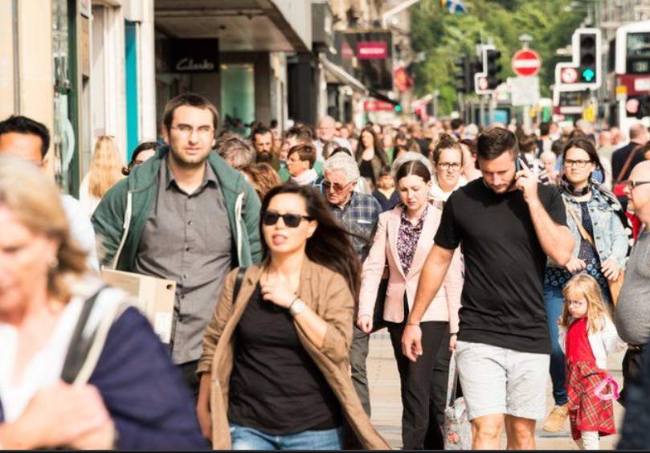
Democracy
Who rules Britain?
?
?
?
?
So… what is Democracy?

Slide 6
Democracy
We have a system of Government called democracy.
Democracy means ‘rule by the people’.
It comes from the Greek words Dêmos, which means people, and krátos which means rule or strength.

Slide 7
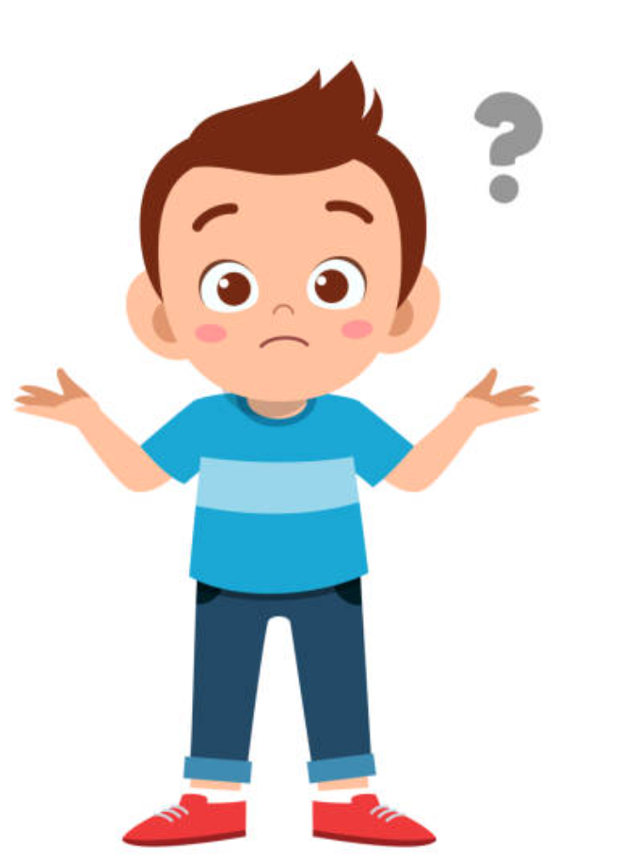
HOW!?
Ruled by everyone?
THAT WOULD BE CHAOS!

Slide 8
https://www.youtube.com/watch?app=desktop&v=BmKrJdMwsks

Slide 9
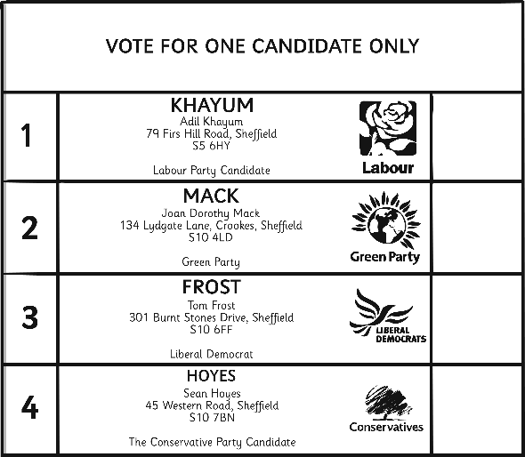
Voting
1. People must be 18 or over in order to take part in an election.
2. Every citizen should listen to the views of the different parties and candidates and then make his or her own decision on whom to support.
3. Each person (voter) votes (‘casts a ballot’) for the candidate of his or her choice. S/he does this by putting a cross beside the person’s name on the ballot paper.
4. People cast their ballots in a booth so that no one can see who they are voting for. This is called a ‘secret ballot’.
5. At the end of the election day, the votes are added up
and the candidate with the highest number of
votes (the majority) is declared the winner.

Slide 10
Let’s vote!
Voting is a way of collecting people’s opinions.
You can show your opinion by standing up or sitting down.
Stay standing if your favourite sport is cricket.
Stay standing if you would like an extra hour of art each week in school
Stay standing if you are left handed and use left handed scissors.
Stay standing if you would like fruit in KS2 like they have
in KS1

Slide 11
Task
Think of an idea that people may vote for or against.
Write or draw it on your post-it.
Let’s take a vote

Slide 12
Physical Activity
We are going to play different multi-skill games.
Can we vote on some different rules for each game?
KEY QUESTION:
What is democracy?

