Slide 1
British Values

Slide 2
British Values
The Rule of Law
Democracy
Individual Liberty
Mutual respect of those with different faiths and beliefs

Slide 3
British Values
The Rule of Law
Democracy
Individual Liberty
Mutual respect of those with different faiths and beliefs

Slide 4
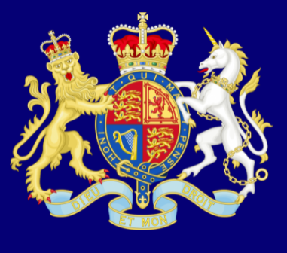
Recap
The Rule of Law
What is it?
The rule of law is what keeps our society together and what helps us live a happy life.

Slide 5
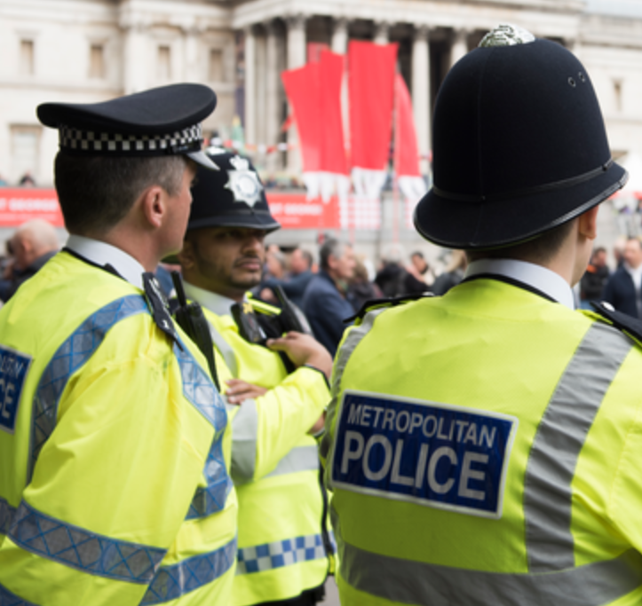
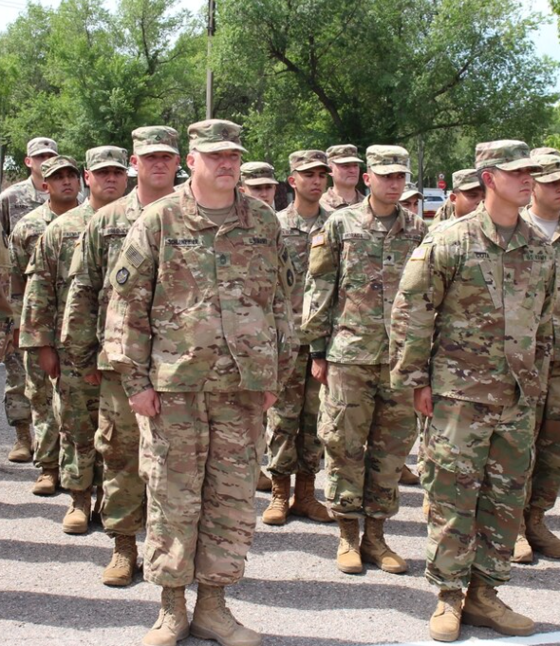
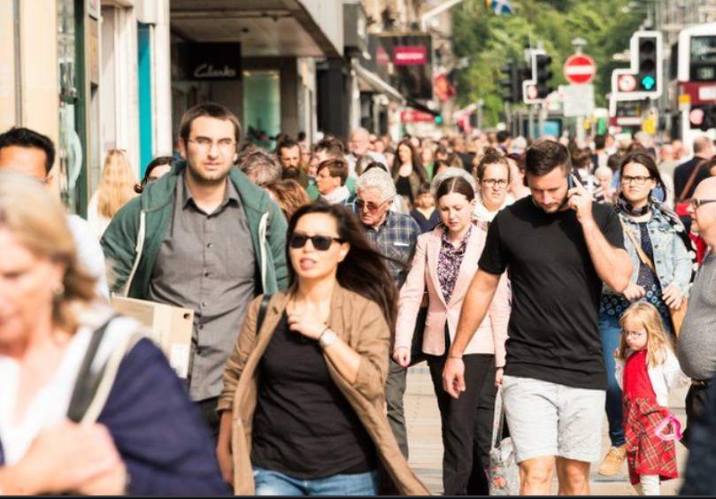
Democracy
Who rules Britain?
?
?
?
?
So… what is Democracy?

Slide 6
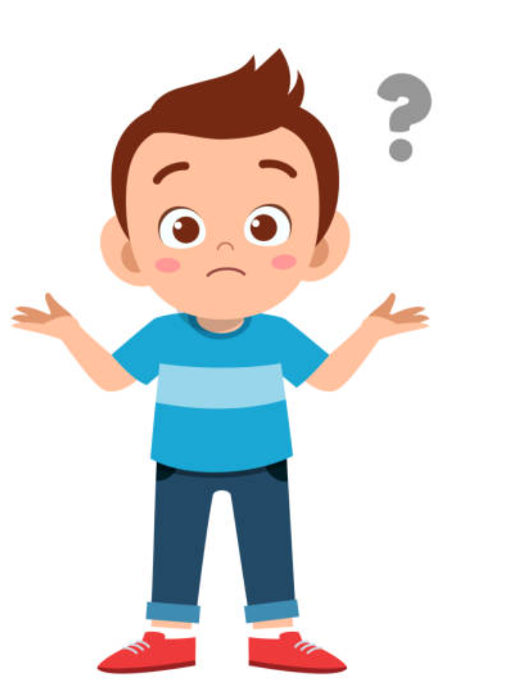
Democracy
‘Rule by the people’
HOW!?
Ruled by everyone?
THAT WOULD BE CHAOS!

Slide 7
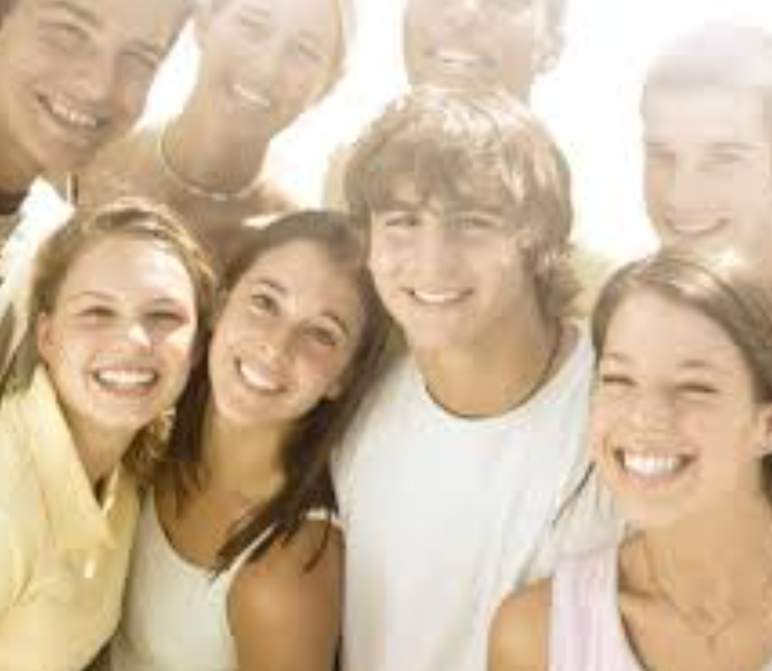
In Britain…
we
can all make
decisions by voting

Slide 8
Let’s Vote
Stand up or sit down
Who would like to come to school on the weekend?

Slide 9
Let’s Vote
Stand up or sit down
Who would like to have McDonalds for lunch at school each day?

Slide 10
Let’s Vote
Stand up or sit down
Who would like to bring their pets to school each day so they can sit next to them in class?

Slide 11
Let’s Vote
Stand up or sit down
Who would like to bring their pets to school each day so they can sit next to them in class?

Slide 12
Task
Think of an idea that people may vote for or against.
Write or draw it on your post-it.
Let’s take a vote

Slide 13
Physical Activity
We are going to play different multi-skill games.
Can we vote on some different rules for each game?
KEY QUESTION:
What is democracy?

