Slide 1
British Values

Slide 2
Can you name them all?
British Values

Slide 3
British Values
The Rule of Law
Democracy
Individual Liberty
Mutual respect of those with different faiths and beliefs

Slide 4
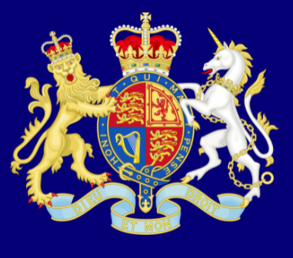
Recap
The Rule of Law
What is it?
The rule of law is what keeps our society together and what helps us live a happy life.

Slide 5
Recap
Democracy
What is it?
Democracy means ‘rule by the people’.

Slide 6
Individual Liberty
Recap
What is it?
‘I’m free to be me’

Slide 7
Mutual Respect for Different Faiths
Recap
What is it?

Slide 8
Today is our…
Election Day!
$$√$$
Political parties
$$√$$
Political leaders
$$√$$
Manifesto
Ballot paper
$$√$$

Slide 9
Today we have only two political parties
Leader
Leader
?
?
manifesto
manifesto
The blue party
The orange party

Slide 10
Let’s take a vote

