Slide 2
Rights & Responsibilities

Slide 3
Our aim:
- I can understand the difference between a right and a responsibility
- I can identify what my rights and responsibilities are
- I can demonstrate responsibility during physical activity

Slide 4
What is a RIGHT?
A right is...
a moral or legal entitlement to have or do something:
[with infinitive] : she had every right to be angry
you’re quite within your rights to ask for your money back
[mass noun] :there is no right of appeal against the decision

Slide 5
RIGHTS
Survive
Participate
Grow
Fulfil your potential
(The UN Convention of the rights on children, 1990)

Slide 6
TASK 1
Time challenge!

Slide 7
Can you list as many rights as you can?

Slide 8
What is a RESPONSIBILITY?
A responsibility is...
(responsibility to/towards) a moral obligation to behave correctly towards or in respect of:
individuals have a responsibility to control their behaviour

Slide 9
TASK 2
Rights linked to Responsibilities

Slide 10
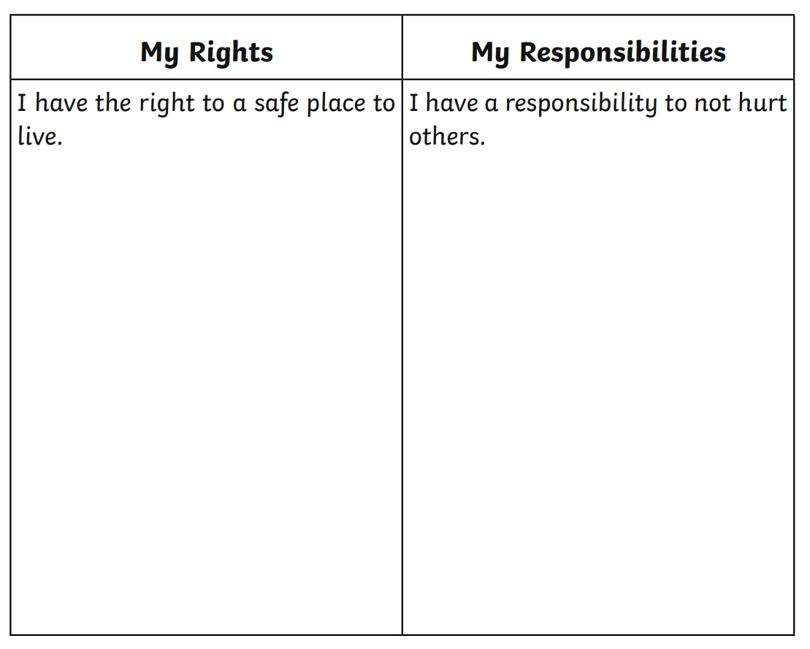

Slide 11
“A true leader takes responsibility for their team and helps them achieve goals”

Slide 12
What does this plant need to survive and grow?
Your class is responsible!!

