Slide 2
Money

Slide 3
Our aims:
- I can understand why it is important to get a job and what different people earn
- I can decide what is value for money by comparing prices of different items
- I can decide how spending and saving can affect others

Slide 4
TASK 1
SALARY QUIZ

Slide 5
Painter and decorator
£17,000 - £32,000
Specialist doctor
£42,000 - £77,000
CEO
£20,000 - £40,000
£45,000 +
Waitress / Waiter
£16,000 - £23,000
Police officer

Slide 6
Why should we get a job?
It will earn you money
You can learn and grow as a person
from the experiences
You could contribute to your community
and have a feeling of self-worth

Slide 7
TASK 2
VALUE FOR MONEY?

Slide 8
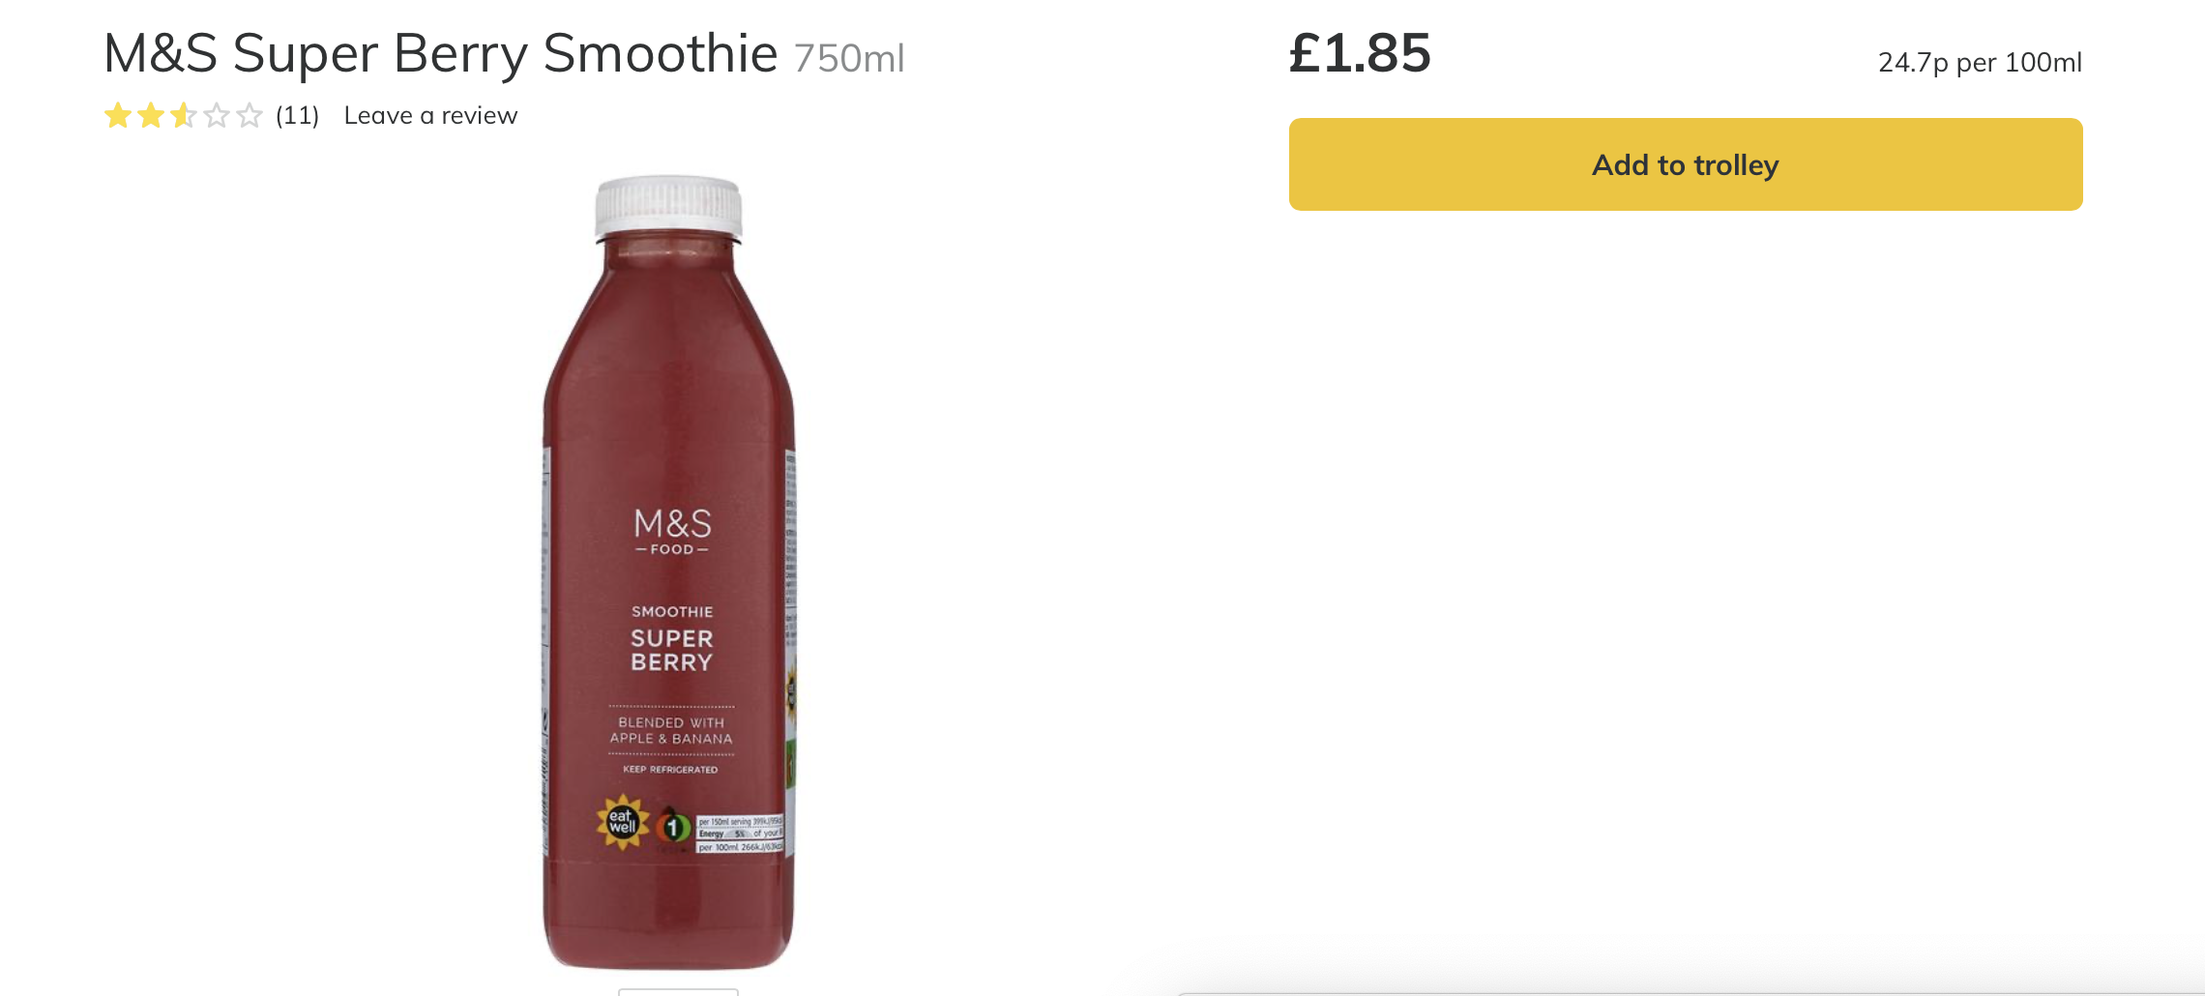
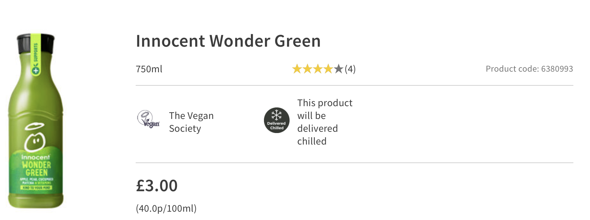

Slide 9
How can spending and saving affect myself and others?
You have security with savings
You can support your family (food, shelter)
You can do things you enjoy

Slide 10
So what’s important?
That we are aware of what people earn and why getting a job is important
That we can make good choices about spending and saving

